Slide 1

Caries Detection With Deep Learning
By Riya robin​

Slide 2

contents
Introduction
Objective
Literature review
Dataset used
Methodology
Results
conclusion
Future scope
references

Slide 3
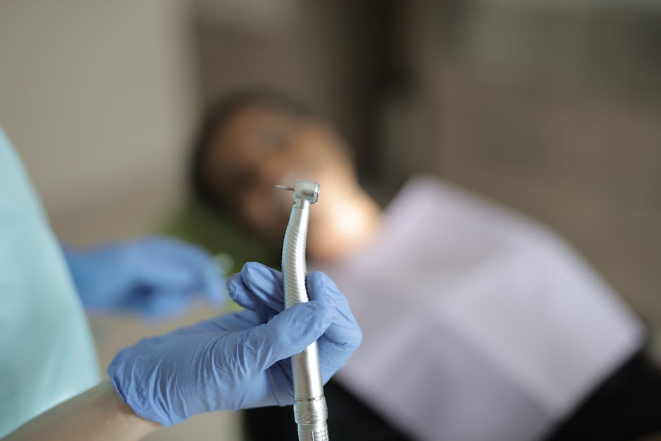
What is dental caries
Dental caries is a prevalent oral health condition.
According to WHO, Caries is defined as a localized post eruptive, pathological process of external origin involving softening of the hard tooth tissue and proceeding to the formation of cavity.

Slide 4
Caries detection using transfer LEARNING
The Convolutional Neural Networks (CNN), a promising algorithm, has shown potential in medical image recognition applications as effective models for extracting relevant features from images.
But it is practically difficult to provide enough data to train the deep networks due to lack of publicly available datasets.

Slide 5
Caries detection using transfer LEARNING
Transfer learning is a method that allows us to use knowledge gained from other tasks in order to tackle new but similar problems quickly and effectively.
Useful when you have insufficient data for a new domain you want to be handled by a neural network and there is a big pre-existing data pool that can be transferred to your problem.

Slide 6
Literature review
Various techniques for caries detection have been introduced, encompassing both conventional image processing approaches and deep learning (DL)-based methods. Statistical features derived from operations like Laplacian/Gaussian filters, image dilation, and erosion are employed in combination with a multilayer perceptron (MLP) for caries detection. [2]
In the classification phase, a diverse range of classifiers can be employed, including support vector machines (SVM), Naive Bayes (NB), deep learning models, decision trees(DT), XG-Boost, k-nearest neighbor (KNN), and random forests (RF) [3].

Slide 7
3. To achieve high accuracy, these techniques frequently use massive datasets and extremely deep networks [5].
4. Finding high-quality labelled datasets for model training is, however, not always easy in the real world simple. [4].
5. It's also widely known that manually labelling a dataset is time consuming a very difficult and error-prone task. Thus, we suggest that this work's early warning learning strategy be examined using a classification based on CNNs. CNN can be used to analyze and categorize the patterns in radiographs. [6]

Slide 8
methodology
Dental Caries detection
Input Image
Image Enhancement
Image Segmentation
Neural Network Classifier
Object Detection

Slide 9
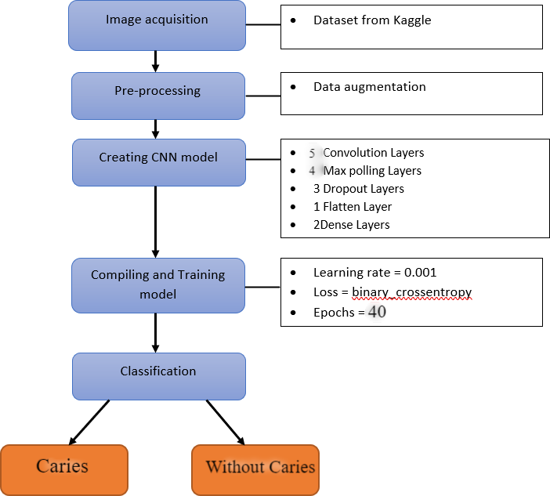
Fig 1. Workflow of CNN

Slide 10
dataset
The Mendeley Data platform is the source of the dataset used in this study.
There are 116 panoramic dental radiography images in this dataset, measuring 2964 × 1464.
Dataset contains x-rays with dental caries and without dental caries.

Slide 11
Pre-processing and image augmentation
We have used ImageDataGenerator from keras.preprocessing.image in python.
These generators will help preprocess and augment the data.
Images were augmented using- Rotation, Vertical Flip and Horizontal Flip for our model.

Slide 12
Architecture of the cnn model
We have created a Sequential model which contains 9 layers.
Training dataset was used at a learning rate of 0.001 and 40 epochs were used.

Slide 13
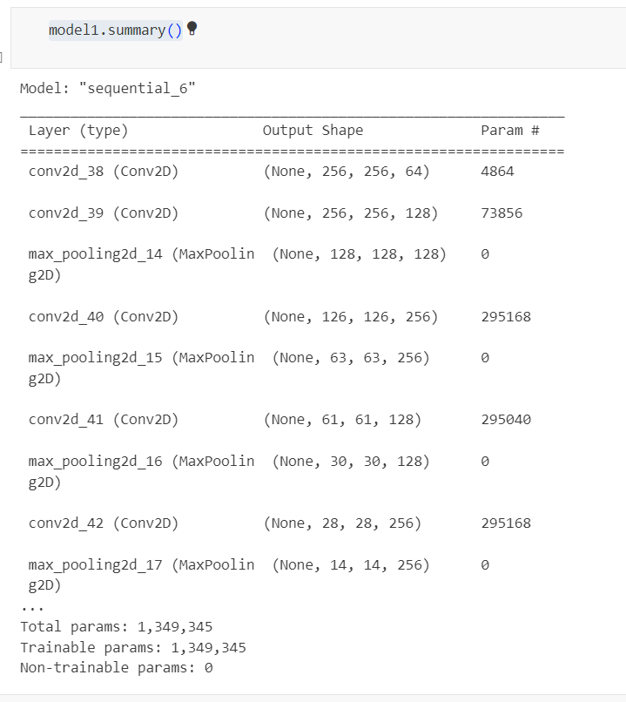
Fig 2. Model summary of CNN architecture

Slide 14
Input Layer:
Our input image, as the name implies, can be either RGB or Grayscale. Each picture is composed of pixels with values between 0 and 255.
Before sending them to the model, we must normalize them, or transform the 0 to 1 range.

Slide 15
2. Convolution Layer:
The filter used to extract or identify the characteristics of our input picture is applied to it in the convolution layer.
Multiple filtering operations are performed on the picture to produce a feature map that aids in categorizing the input image.

Slide 16
3. Pooling Layer:
Following the convolutional layer, the pooling layer is used to shrink the feature map's size, assisting in the preservation of the input image's key details or features while speeding up computation.
Max Pooling and Average Pooling are the two most popular forms of pooling.

Slide 17
4. Fully connected Layer:
We have completed the Feature Extraction processes up to this point; the next step is Classification.
The input picture is classified into a label using the fully connected.
This layer links the output layer to the data obtained from the preceding steps—the convolution layer and the pooling layer—and ultimately assigns the input the desired label.

Slide 18
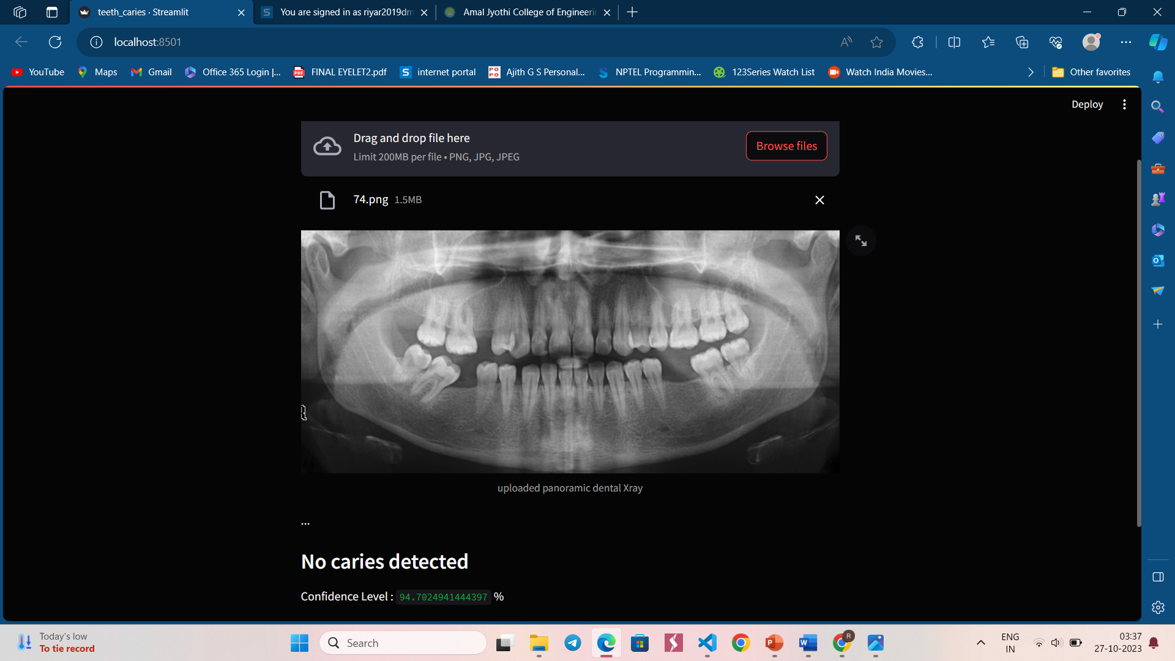
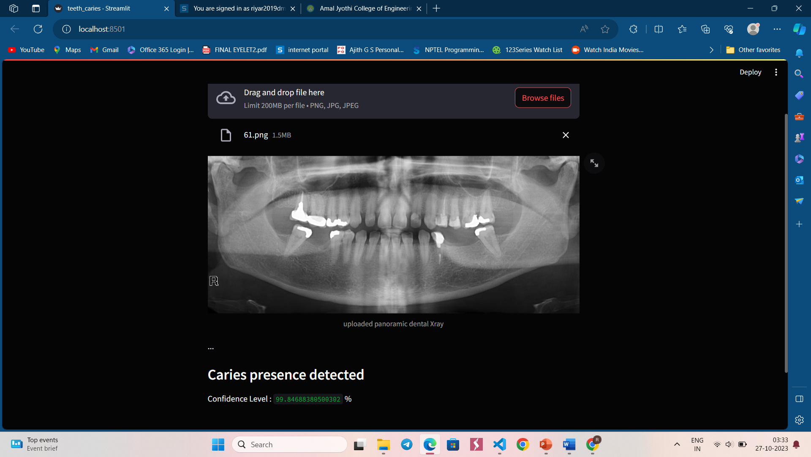
result
Fig 3. Without Caries
Fig 4. With Caries

Slide 19
Confidence level
“Confidence level" typically refers to the degree of certainty or confidence that the model has in its predictions.
This is closely related to the concept of prediction uncertainty and can be important for various applications, especially in classification tasks.

Slide 20
In the case of classification of dental caries and non-caries, our CNN model was created with binary cross entropy loss with learning rate of 0.001.
However, the accuracy can be increased by increasing the dataset images.
We tested the model by tuning hyperparameters and achieved a maximum accuracy of 94%.

Slide 21
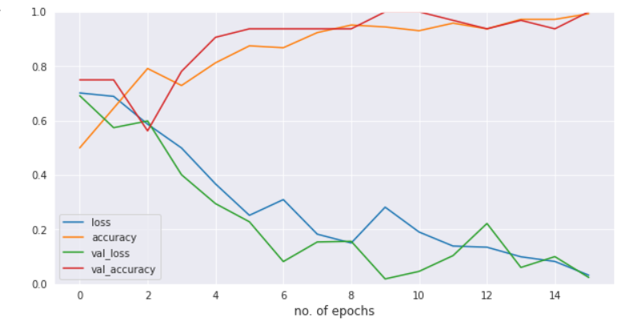
Dental Caries detection
Figure 5. Training accuracy and loss with epochs

Slide 22
CONCLUSION
Dental Caries detection
In this paper, we proposed a deep learning-based CNN algorithm for identifying dental caries from panoramic X-rays using the transfer learning technique.
It exhibits significant effectiveness in precise detection and diagnosis of dental caries in panoramic radiographs

Slide 23
Future scope
May be able to classify diseases such as periodontal diseases, impacted teeth, oral cysts, root canal infections etc.
Can gather X-ray images from medical centres in the future to train and test the model in order to predict better outcomes.

Slide 24
references
Joao Oliveira and Hugo Proenca, “Caries Detection in Panoramic Dental X-ray” [Computational Vision and Medical Image Processing (pp.175-190), Nov 2010]
Adnan Qayyum, Ahsen Tahir, Muhammad Atif Butt, Alexander Luke, Hasan Tahir Abbas, Junaid Qadir, Kamran Arshad, Khaled Assaleh, Muhammad Ali Imran & Qammer H.Abbasi, “Dental caries detection using a semi-supervised learning approach” [Scientific Reports volume 13, Article number: 749, January 2023]

Slide 25
3. Jae-Hong Lee a, Do-Hyung Kim a, Seong-Nyum Jeong a, Seong-Ho Choi, “Detection and diagnosis of dental caries using a deep learning-based convolutional neural network algorithm” [Journal of dentistry, Vol 77, October 2018]. 4. Srivastava, M.M. Kumar, P.Pradhan, L.Varadarajan, “Detection of Tooth caries in Bitewing Radiographs using Deep Learning” [In Proceedings of the Thirty-first Annual Conference on Neural Information Processing Systems (NIPS 2017), Long Beach, CA, USA, December 2017].

Slide 26
5. Abdullah S. AL-Malaise AL- Ghamdi , Mahmoud Ragab, Saad Abdulla AlGhamdi, Amer H. Asseri, Romany F. Mansour, Deepika Koundal, “Detection of Dental Diseases through X-Ray Images Using Neural Search Architecture Network” [Computational Intelligence and Neuroscience, April 2022]
6. Oztekin F, Katar O, Sadak F, Yildirim M, Cakar H, Aydogan M, Ozpolat Z, Talo Yildirim T, Yildirim O, Faust O, Acharya UR, “An Explainable Deep Learning Model to Prediction Dental Caries Using Panoramic Radiograph Images” [Diagnostics (Basel), Jan 202

Slide 27

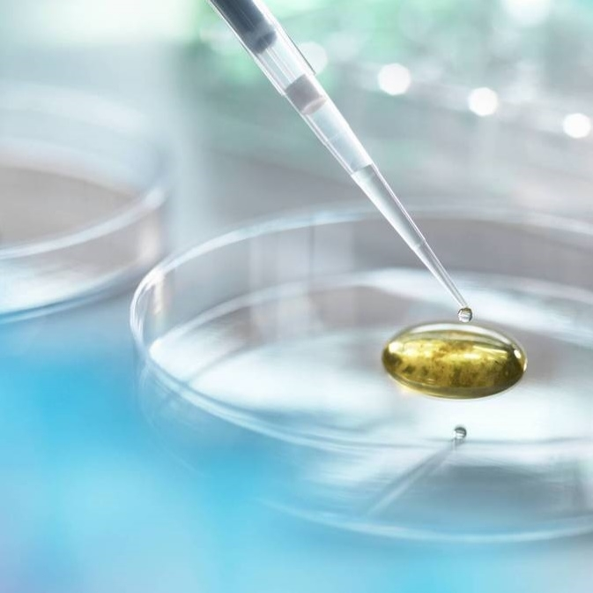
Thank you

